Slide 2
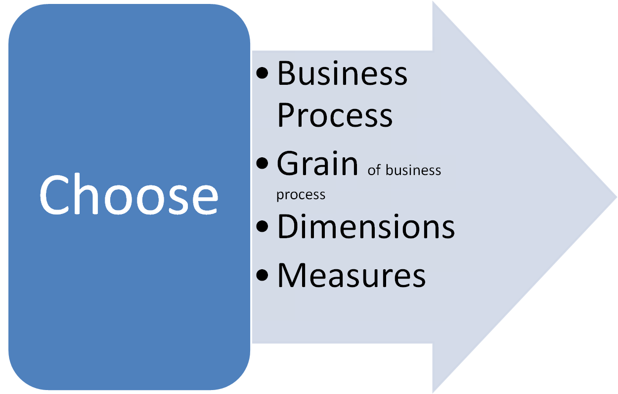
Data Warehouse Design

Slide 3
THREE TIER ARCHITECTURE

Slide 4

Query/ report | Analysis | Data Mining |  | Top tier: front-end tools
 |  |  |  | Middle tier: OLAP server
OLAP server |  |  | OLAP server
Metadata Repository |  | Data Warehouse | Data marts | Bottom tier: data warehouse server
Operational databases |  |  | External Sources | Data
Output
Monitoring
Administration
Extract Clean Transform Load Refresh

Slide 5
Three Data Warehouse Models
Enterprise warehouse
  collects all of the information about subjects spanning the entire organization
Data Mart
  a subset of corporate-wide data that is of value to a specific groups of users. Its scope is confined to specific, selected groups, such as marketing data mart
    Independent vs. dependent (directly from warehouse) data mart
Virtual warehouse
  A set of views over operational databases
  Only some of the possible summary views may be materialized

Slide 6
OLAP Server Architectures
Relational OLAP (ROLAP)
  Use relational or extended-relational DBMS to store and manage warehouse data and OLAP middle ware to support missing pieces
  Include optimization of DBMS backend, implementation of aggregation navigation logic, and additional tools and services
  greater scalability
Multidimensional OLAP (MOLAP)
  Array-based multidimensional storage engine (sparse matrix techniques)
  fast indexing to pre-computed summarized data
Hybrid OLAP (HOLAP)
  User flexibility, e.g., low level: relational, high-level: array
Specialized SQL servers
  specialized support for SQL queries over star/snowflake schemas

Slide 7

Efficient Data Cube Computation
Data cube can be viewed as a lattice of cuboids
  The bottom-most cuboid is the base cuboid
  The top-most cuboid (apex) contains only one cell
  How many cuboids in an n-dimensional cube with L levels?
Materialization of data cube
  Materialize every (cuboid) (full materialization), none (no materialization), or some (partial materialization)
  Selection of which cuboids to materialize
    Based on size, sharing, access frequency, etc.

Slide 8
Cube Operation
Transform it into SQL-like language (with new operator cube by, introduced by Gray et al.’96)
    SELECT item, city, year, SUM (amount)
    FROM SALES
    CUBE BY item, city, year
Need compute the following Group-Bys
    (item, city, year),
    (item, city), (item, year), (city, year),
    (item), (city), (year)
    ()
()
(city)
(item)
(year)
(city, item)
(city, year)
(item, year)
(city, item, year)

Slide 9
Cuboids Corresponding to the Cube
all
0-D(apex) cuboid
product
date
country
1-D cuboids
product,date
product,country
date, country
2-D cuboids
3-D(base) cuboid
product, date, country

Slide 10

Browsing a Data Cube
Visualization
OLAP capabilities
Interactive manipulation

Slide 11
Efficient Processing of OLAP Queries
Determine which operations should be performed on the available cuboids:
  transform drill, roll, etc. into corresponding SQL and/or OLAP operations, e.g, dice = selection + projection
Determine to which materialized cuboid(s) the relevant operations should be applied.
Exploring indexing structures and compressed vs. dense array structures in MOLAP

Slide 12
Metadata Repository
Meta data is the data defining warehouse objects. It has the following kinds
  Description of the structure of the warehouse
    schema, view, dimensions, hierarchies, derived data defn, data mart locations and contents
  Operational meta-data
    data lineage (history of migrated data and transformation path), currency of data (active, archived, or purged), monitoring information (warehouse usage statistics, error reports, audit trails)
  The algorithms used for summarization
  The mapping from operational environment to the data warehouse
  Data related to system performance
  Business data
    business terms and definitions, ownership of data, charging policies

Slide 13
OLAM→ OLAP + Data Mining
High quality of data in data warehouse
Infrastructure around data warehouses
Exploratory data analysis
Online DM function selection

Slide 14
Constraint based mining query
Mining Result
Layer 4
User Interface
Graphical User Interface API
OLAM Engine
OLAP Engine
Layer 3
OLAP/OLAM
Cube API
MDDB
Meta data
Layer 2
Multidimensional
database
Database API
Data filtering
Data Integration
Filtering
Layer 1
Data repository
Databases
Databases
Data
Warehouse
Data Cleaning
Data Integration

Slide 15
Discovery-Driven Exploration of Data Cubes
Hypothesis-driven: exploration by user, huge search space
Discovery-driven (Sarawagi et al.’98)
  pre-compute measures indicating exceptions, guide user in the data analysis, at all levels of aggregation
  Exception: significantly different from the value anticipated, based on a statistical model
  Visual cues such as background color are used to reflect the degree of exception of each cell
  Computation of exception indicator (modeling fitting and computing SelfExp, InExp, and PathExp values) can be overlapped with cube construction

Slide 16



Examples: Discovery-Driven Data Cubes

